Slide 1
CB Program Guide for Students
Updated December 2019
Program Director: Dr. Larry Matherly (matherly@karmanos.org)
Program Manager: Nadia Daniel (danieln@karmanos.org)
Graduate Officer: Dr. George Brush (brushg@karmanos.org)

Slide 2
Year 1
Winter
Academic
CB7210
IBS Electives (2)
CB7700 Journal Club - First Presentation
CB7890 Seminar - First Presentation
CB7800 Rigor and Reproducibility in Cancer Research
Register for Spring/Summer Classes by March 31st
Email Nadia with override requests by March 31st
Research
Final Lab Rotation - Complete Appraisal(s)
Select mentor and email selection/reason to Nadia to be presented before steering committee
If mentor selection approved sign and submit to Nadia Mentor Student Agreement
CB Program Participation
CB Symposium presentation
Grand Rounds Attendance (80%)
Fall
Academic
IBS 7015
CB 7700 Journal Club
CB7890 Seminar
Register for Winter semester by November 30th
Email Nadia with any overrides by November 30th
Research
CB7710 Lab Rotation(s) - Complete Rotation Appraisal Report(s)
CB Program Participation
Review CB program Guidelines
Grand Rounds Attendance (at least 80%)

Slide 3
Year 1 Continued
Summer
Academic
CB7130 Clinical Rotations
Register for Fall Classes by July 31st
Email Nadia with override request by July 31st
Research
Work on developing dissertation aims
CB Program Participation
Written comprehensive in May
You will receive an email in early May to meet with Dr. Matherly which will outline the expectations of the written comprehensive
Read Emperor of All Maladies (Nadia has several copies, you don’t need to purchase, Audiobook while driving is also an option)
Write a 2 page summary of book and reflections on experience in clinic. Email to Nadia.

Slide 4
Year 2
Winter
Academic
CB7700 Journal Club
CB7890 Seminar
Register for Spring/Summer Classes by March 31st
Email Nadia with override requests by March 31st
Research
Define aims for dissertation and collect data
CB Program Participation
Begin writing prospectus for Oral Defense in May
Prospectus Instructions
Identify thesis committee members
CB Symposium presentation
Grand Rounds Attendance (80%)
Present for T32 funding upon mentor recommendation
1 page abstract and 15 minute presentation
Fall
Academic
CB7700 Journal Club
CB7890 Seminar
Register for Winter semester by November 30th
Email Nadia with any overrides by November 30th
Research
Define aims for dissertation and collect data
CB Program Participation
Fill out plan of work and meet with Dr. Brush to discuss and for approval (examples are at the end of powerpoint)
Grand Rounds Attendance (at least 80%)

Slide 5
Oral Qualifying Examine (May of 2nd Year, 1st Year for MD/PhD students)
-Your oral qualifying exam is also your first committee meeting. You will present your research as described in your prospectus to your committee and answer questions about it.
-Meeting should be scheduled for mid- to late May.
-Prospectus should be sent to committee members to read at least a week in advance of your meeting.
-Prospectus instructions: https://cancerbiologyprogram.med.wayne.edu/pdfs/prospectus_instructions_2013.pdf
-Bring the following forms to your committee meeting:
-Recommendation for candidacy status: https://cancerbiologyprogram.med.wayne.edu/pdfs/phd_recommendation_for_candidacy_status_form.pdf
-Prospectus and record of approval: https://cancerbiologyprogram.med.wayne.edu/pdfs/phd_prospectus_and_record_of_approval_form.pdf
-Conflicts of interest: https://cancerbiologyprogram.med.wayne.edu/pdfs/phd_conflict_of_interest_form.pdf

Slide 6
Submitting your prospectus
-Before submitting your prospectus, make sure you have submitted your plan of work (POW) and completed your individual development plan (IDP) with the graduate school.
-IDP: https://gradschool.wayne.edu/phd/ar-idp
-After completing your oral defense, file digital copies to the Cancer Biology Graduate Program Office and ensure that all forms are signed by the Graduate Program Director prior to submitting the hard copies of the following to the Graduate School office at 5057 Woodward, 6th floor:
-Completed recommendation of candidacy status form
-Completed prospectus and record of approval form
-Prospectus
-Completed conflict of interest form
-Transcript (available at Academica)

Slide 7
Year 2 Continued
Summer
Academic
CB7300 F31 Grant Writing Course
CB7300 Principles of Clinical Oncology and Cancer Research (depending on year, may be in summer of 3rd year)
Register for Fall Classes by July 31st
Email Naida with override request by July 31st
Research
Collect data on dissertation aims
Send emails to schedule committee meeting by August
Bi-annual, so plan for November-December (~6 months apart)

Slide 8
Year 3
Fall
Academic
Finish remaining courses if needed
CB7700 Journal Club
CB7890 Seminar
CB9991 Doctoral Status 1
Register for Winter semester by November 30th
Email Nadia with any overrides by November 30th
Research
Collect data for dissertation aims
CB Program
Submit F31 in December
Committee meeting
Submit summary of research to committee at least 3 days prior to meeting
Submit research progress summary and committee recommendations to Nadia no more than 2 days after meeting
Grand Rounds Attendance (at least 80%)
Winter
Academic
Finish remaining courses if needed
CB7700 Journal Club
CB7890 Seminar
CB9992 Doctoral Status 2
Register for Spring/Summer Classes by March 31st
Email Nadia with override requests by March 31st
Research
Collect data for dissertation aims
CB Program
CB Symposium presentation
Committee meeting
Submit summary of research to committee at least 3 days prior to meeting
Submit research progress summary and committee recommendations to Nadia no more than 2 days after meeting
Grand Rounds Attendance (80%)

Slide 9
Year 3 Continued
Summer
Academic
CB7300 Principles of Clinical Oncology and Cancer Research (depending on year, may be in summer of 2nd year)
Doctoral Status
Register for Fall Classes by July 31st
Email Naida with override request by July 31st
Research
Collect data on dissertation aims
CB Program
Submit by June 1st to Nadia a summary of dissertation aims, progress on research and copy of CV to be presented before steering committee
Compete for T32 in May if not awarded an F31 grant
1 page abstract of research and prepare a 15 minute presentation on your project and collected data

Slide 10
Year 4
Fall
Academic
CB7700 Journal Club
CB7890 Seminar
CB9993 Doctoral Status 3
Register for Winter semester by November 30th
Email Nadia with any overrides by November 30th
Research
Collect data on dissertation aims
Write and submit paper(s) on research
CB Program
Resubmit F31 in August or December if not awarded on first submission
Committee meeting
Submit summary of research to committee at least 3 days prior to meeting
Submit research progress summary and committee recommendations to Nadia no more than 2 days after meeting
Grand Rounds Attendance (at least 80%)
Winter
Academic
CB7700 Journal Club
CB7890 Seminar
CB9994 Doctoral Status 4
Register for Spring/Summer Classes by March 31st
Email Nadia with override requests by March 31st
Research
Collect data on dissertation aims
Write and submit paper(s) on research
CB Program
CB Symposium Presentation
Committee meeting
Submit summary of research to committee at least 3 days prior to meeting
Submit research progress summary and committee recommendations to Nadia no more than 2 days after meeting
Grand Rounds Attendance (80%)

Slide 11
Year 4 Continued
Summer
Academic
Research
Register for Fall Classes by July 31st
Email Naida with override request by July 31st
Research
Collect data on dissertation aims
Write and submit paper(s) on research

Slide 12
Year 5 & until graduation
Fall
Academic
CB7890 Seminar
CB9995 Doctoral Candidate Status V (0 credits) placeholder until graduation
Register for Winter semester by November 30th
Email Nadia with any overrides by November 30th
Research
Collect data on dissertation aims
Write and submit paper(s) on research
CB Program Participation
Committee meeting
Submit summary of research to committee at least 3 days prior to meeting
Submit research progress summary and committee recommendations to Nadia no more than 2 days after meeting
Grand Rounds Attendance (80%)
Winter
Academic
Seminar
Doctoral Candidate Status V (0 credits) placeholder until graduation
Register for Spring/Summer Classes by March 31st
Email Nadia with override requests by March 31st
Research
Collect data on dissertation aims
Write and submit paper(s) on research
CB Program
CB Symposium Presentation
Committee meeting
Submit summary of research to committee at least 3 days prior to meeting
Submit research progress summary and committee recommendations to Nadia no more than 2 days after meeting
Grand Rounds Attendance (80%)

Slide 13
Graduation
Ensure you have satisfied academic and publication requirements for graduation
Minimum of 2 research publications, not including a review article, in ISI indexed journals (cited on PubMed)
One of these publications must be a first author
Solicit approval to defend PhD from CB Steering Committee
Minimum of 2 weeks prior to final planned committee meeting, 1 page summary of research accomplishments in relation to each dissertation aim, summary of publications and awards on which PhD will be awarded should be submitted to Nadia
Report should be accompanied by “Application to Defend the PhD in Cancer Biology”
CB Steering Committee will review and approve the progress report and advise the CB Program Director of approval and sign off on departmental form
A copy of departmental form signed by Graduate Program Director and Dissertation committee members should be returned with standard committee meeting form and summary to Nadia
Final Defense Report

Slide 14
Graduation continued
Follow the Degree completion and requirements from the graduate school
PhD Graduation Checklist Graduate School
Follow CB program guidelines for graduation listed in CB Program Guidelines
CB Program Guidelines

Slide 15
Links
Year 1 Links
CB Program Guidelines: http://cancerbiologyprogram.med.wayne.edu/pdfs/phd_guidelines_edits_ned_05162019_lm_ned_lm_ned_lm05162019.pdf
Rotation Appraisal Report: http://cancerbiologyprogram.med.wayne.edu/pdfs/rotation_report_2017.docx
Year 2 Links
Plan of Work: http://cancerbiologyprogram.med.wayne.edu/pdfs/phd_coursework_plan_of_work.pdf
Biannual committee meeting form: http://cancerbiologyprogram.med.wayne.edu/pdfs/biannual_committee_report_2017.docx
-IDP: https://gradschool.wayne.edu/phd/ar-idp
Year 3 Links
Biannual committee meeting form: http://cancerbiologyprogram.med.wayne.edu/pdfs/biannual_committee_report_2017.docx
Year 4 Links
Biannual committee meeting form: http://cancerbiologyprogram.med.wayne.edu/pdfs/biannual_committee_report_2017.docx
Senior Student Links
Biannual committee meeting form: http://cancerbiologyprogram.med.wayne.edu/pdfs/biannual_committee_report_2017.docx
General Program Information: https://cancerbiologyprogram.med.wayne.edu/resources

Slide 16
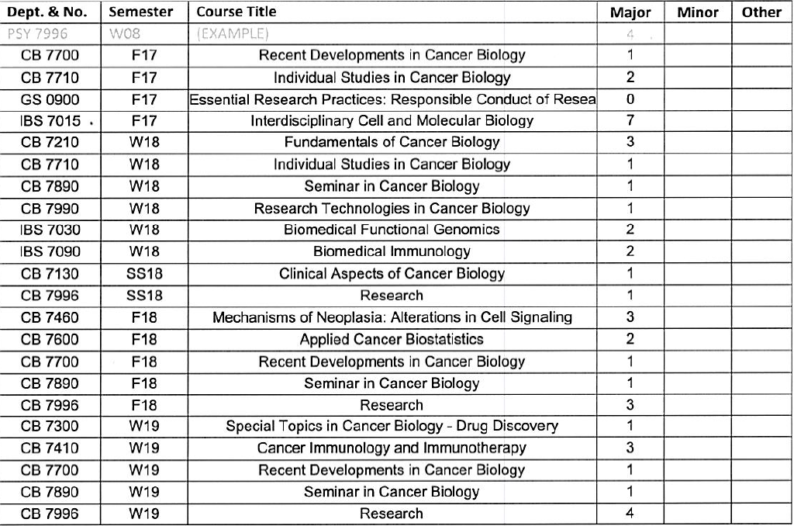
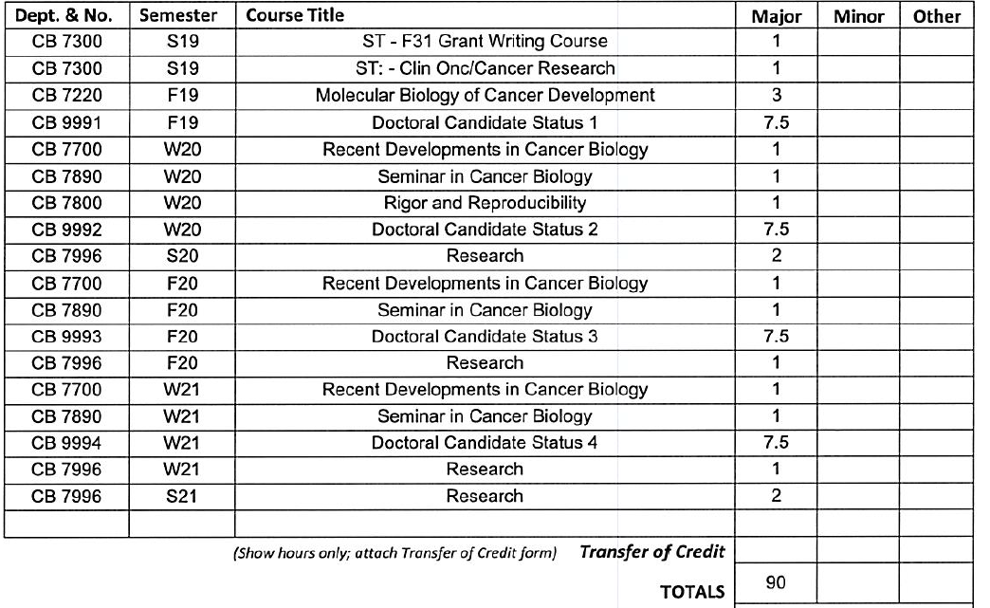
Plan of work example 1 - 1st year odd
Keep in mind courses and requirements may change. It is best to verify all academic questions with Dr. Brush.

Slide 17
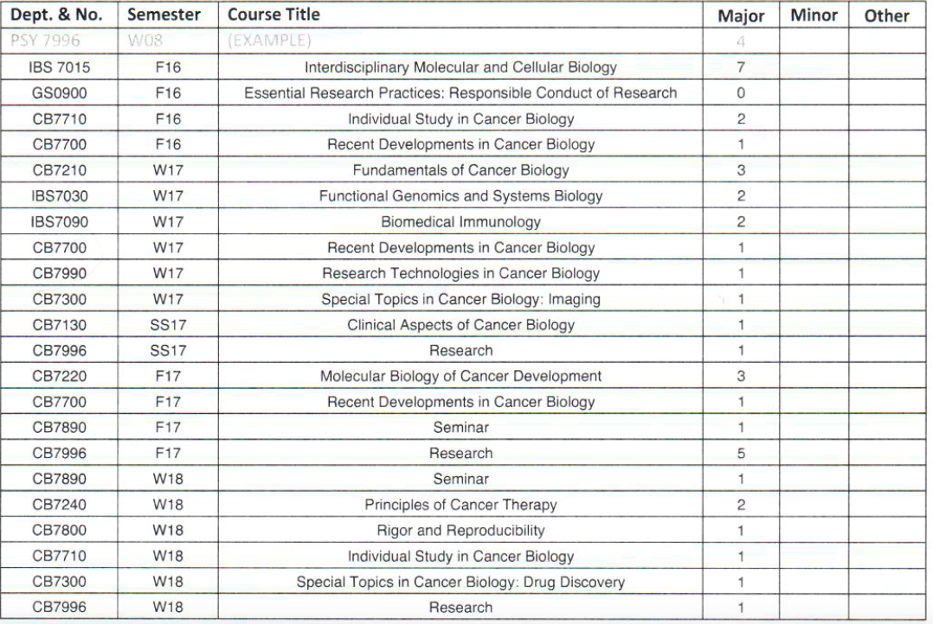
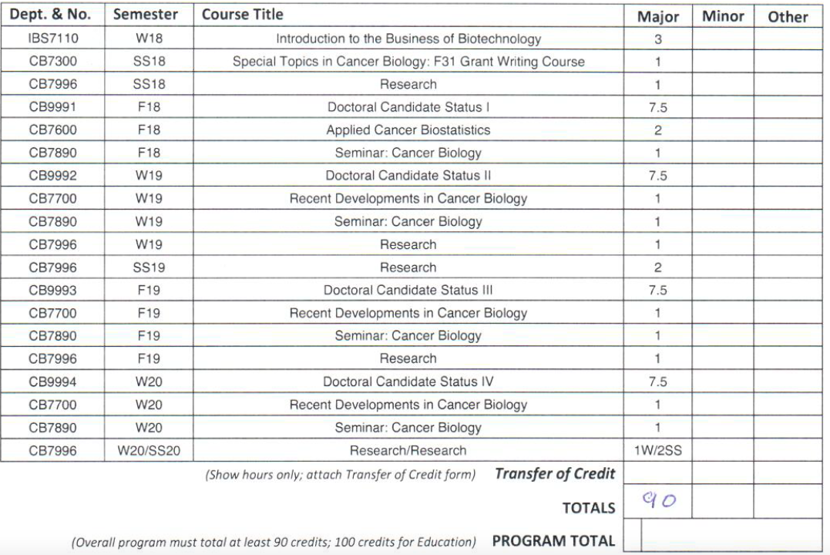
Plan of work example 2 - 1st year even
Keep in mind courses and requirements may change. It is best to verify all academic questions with Dr. Brush.

